Slide 1
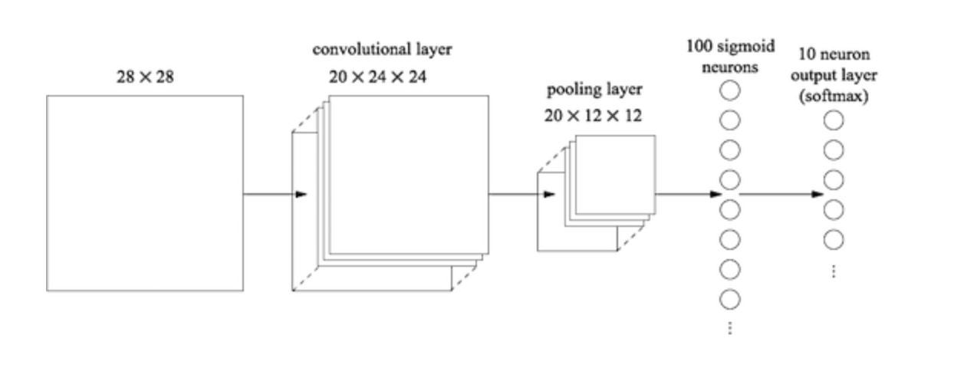
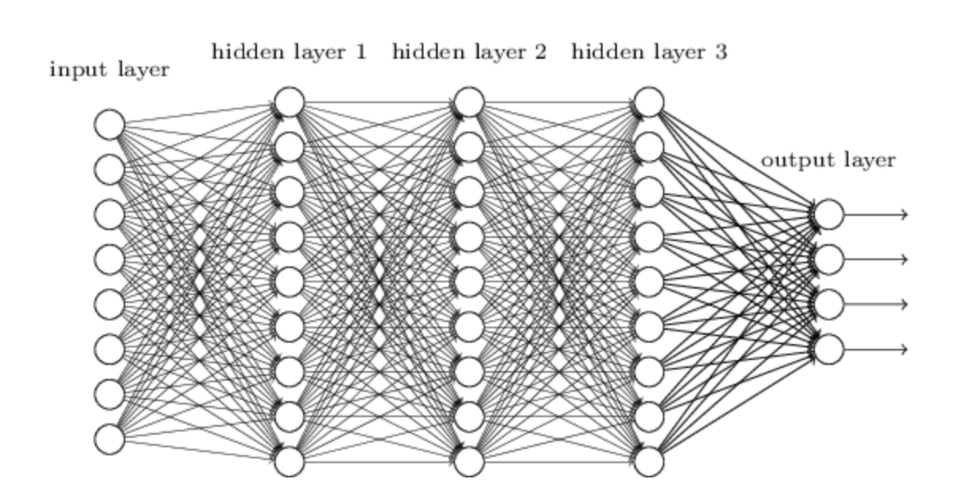
Multilayer neural networks

Slide 2
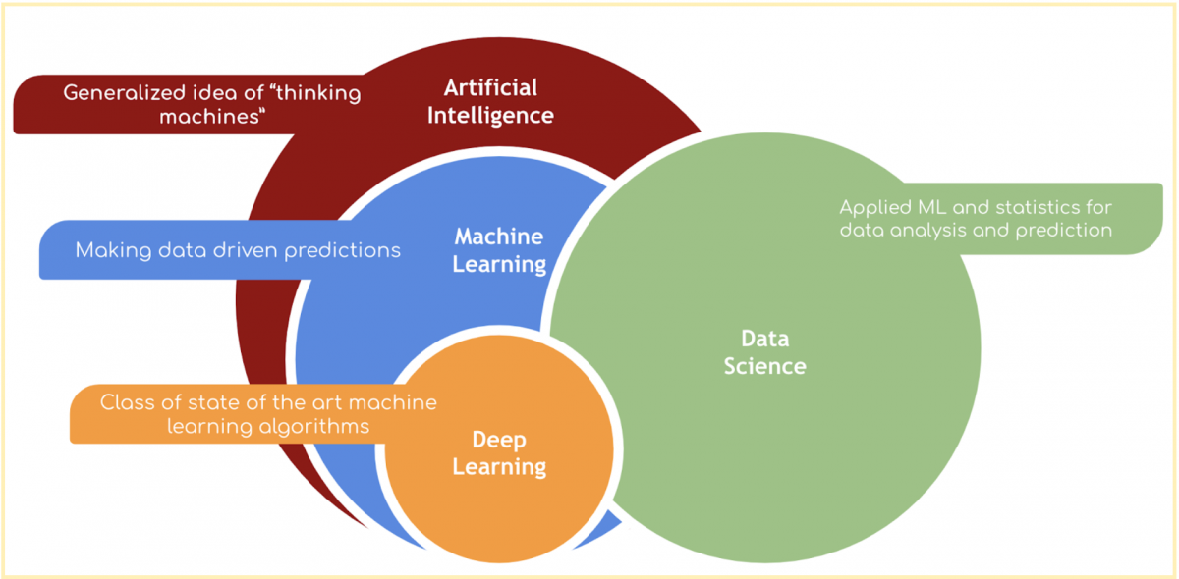
Supervised
Learning
(Good) data
A model of the data
An objective function
Partitioning of the dataset
Predictions & interpretation

Slide 3
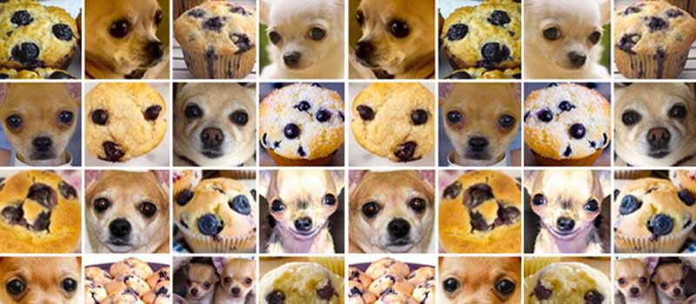
Introduction to multilayer neural networks
Introduce you to the basics of neural networks and multilayer neural networks (MLNNs) aka “deep learning”
Cover basic terminology
Highlight some limitations of MLNNs
Construct some basic neural networks for regression and image analysis
#ChihuahuaOrMuffin

Slide 4
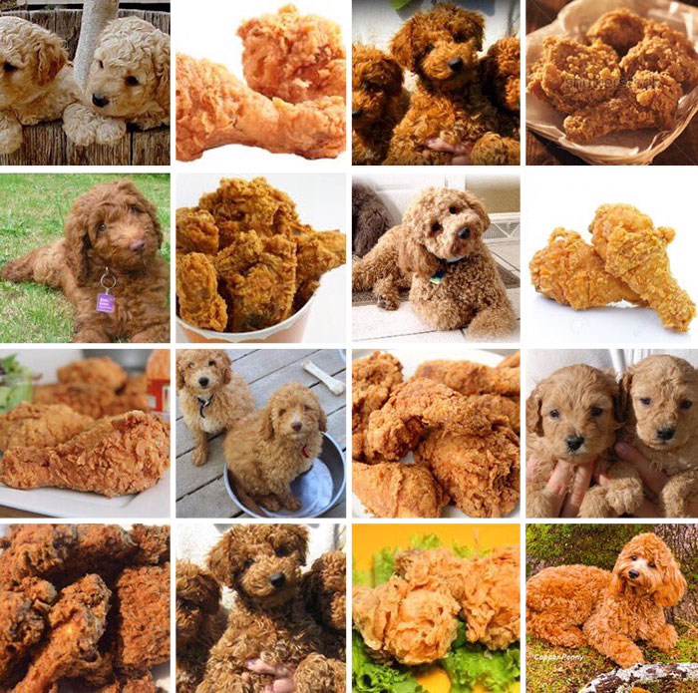
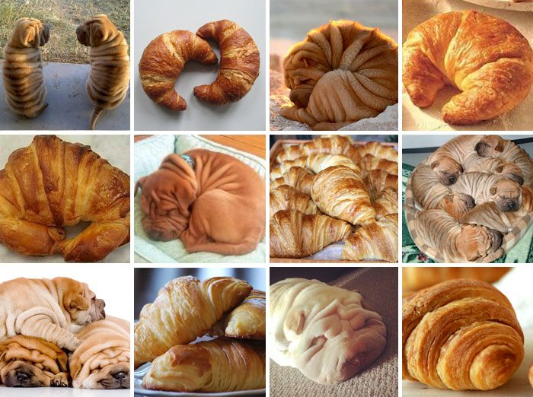

Introduction to multilayer neural networks
#LabradoodleOrFriedChicken
#SharPeiOrCroissant

Slide 5
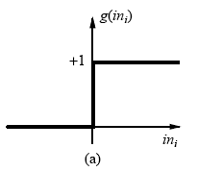
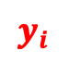

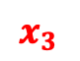

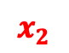
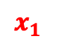
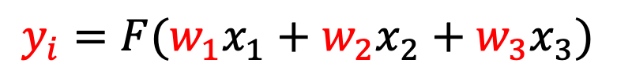

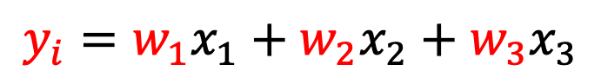
Neural networks
Input
$$x_{1}$$
Output
$$w_{1}$$
Neuron
Example: Perceptron
$$w_{2}$$
$$x_{2}$$
$$y_{i}$$
$$w_{3}$$
$$x_{3}$$
$$y_{i}=w_{1}x_{1}+w_{2}x_{2}+w_{3}x_{3}$$
$$y_{i}=F(w_{1}x_{1}+w_{2}x_{2}+w_{3}x_{3})$$

Slide 6
Neural networks
Input
$$x_{1}$$
Output
$$w_{1}$$
Neuron
Example: Perceptron
$$w_{2}$$
$$x_{2}$$
$$y_{i}$$
$$w_{3}$$
$$x_{3}$$
$$y_{i}=w_{1}x_{1}+w_{2}x_{2}+w_{3}x_{3}$$
$$y_{i}=F(w_{1}x_{1}+w_{2}x_{2}+w_{3}x_{3})$$

Slide 7
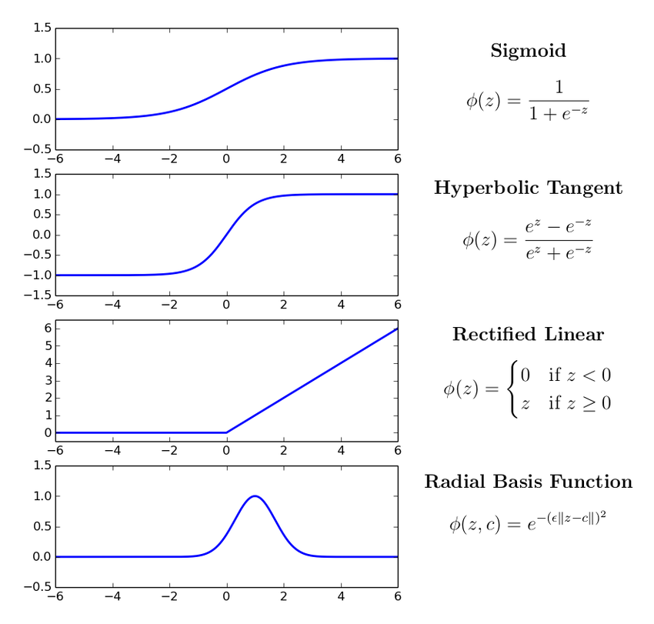
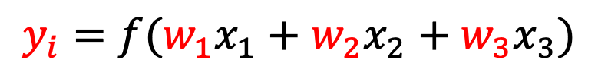
Neural networks
Input
$$x_{1}$$
Output
$$w_{1}$$
Neuron
$$w_{2}$$
$$x_{2}$$
$$y_{i}$$
$$w_{3}$$
$$x_{3}$$
$$y_{i}=w_{1}x_{1}+w_{2}x_{2}+w_{3}x_{3}$$
$$y_{i}=f(w_{1}x_{1}+w_{2}x_{2}+w_{3}x_{3})$$

Slide 8
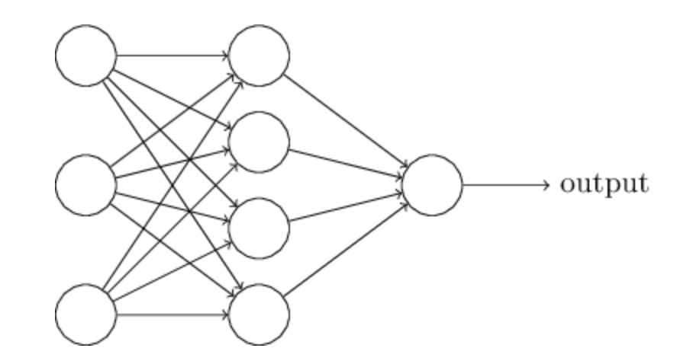
Neural networks
Input
Hidden
Output
Example: 3-input nodes = 3D input
1-output nodes = 1D input
(Nielsen, Neural networks and deep learning)
Neural network: Input nodes → one hidden layer nodes → output nodes

Slide 9
Neural networks

Slide 10
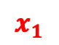
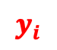


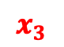


Neural networks
$$x_{1}$$
$$w_{1}$$
$$x_{2}$$
$$w_{2}$$
$$y_{i}$$
$$w_{3}$$
$$x_{3}$$
$$y_{i}=w_{1}x_{1}+w_{2}x_{2}+w_{3}x_{3}+bias$$

Slide 11
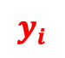





Neural networks
$$x_{1}$$
$$w_{1}$$
$$x_{2}$$
$$w_{2}$$
$$y_{i}$$
$$w_{3}$$
$$x_{3}$$
$$y_{i}=w_{1}x_{1}+w_{2}x_{2}+w_{3}x_{3}+bias$$
$$y_{i}=f(w_{1}x_{1}+w_{2}x_{2}+w_{3}x_{3}+bias)$$

Slide 12
Neural networks
$$w_{1}$$
$$w_{2}$$
$$y_{i}$$
$$w_{3}$$
$$y_{i}=w_{1}x_{1}+w_{2}x_{2}+w_{3}x_{3}+bias$$
Hidden layers are essentially representing different projections/representations of the input
$$y_{i}=f(w_{1}x_{1}+w_{2}x_{2}+w_{3}x_{3}+bias)$$

Slide 13
Neural networks
Final layer then combines these various representation
How this final layer is activated will determine the task

Slide 14
Neural networks
Can calculate a loss function with respect to the various parameters (backpropagation)

Slide 15
Neural networks
Constructing a network in keras (R)
CODE (keras in R)
mod <- keras_model_sequential() %>%
layer_flatten(input_shape = c(1,3)) %>%
layer_dense(units = 4, activation = "relu")
layer_dense(1, activation = ”sigmoid")
activation="sigmoid")
Neural network: Input nodes → one hidden layer nodes → output nodes
activation="linear")

Slide 16
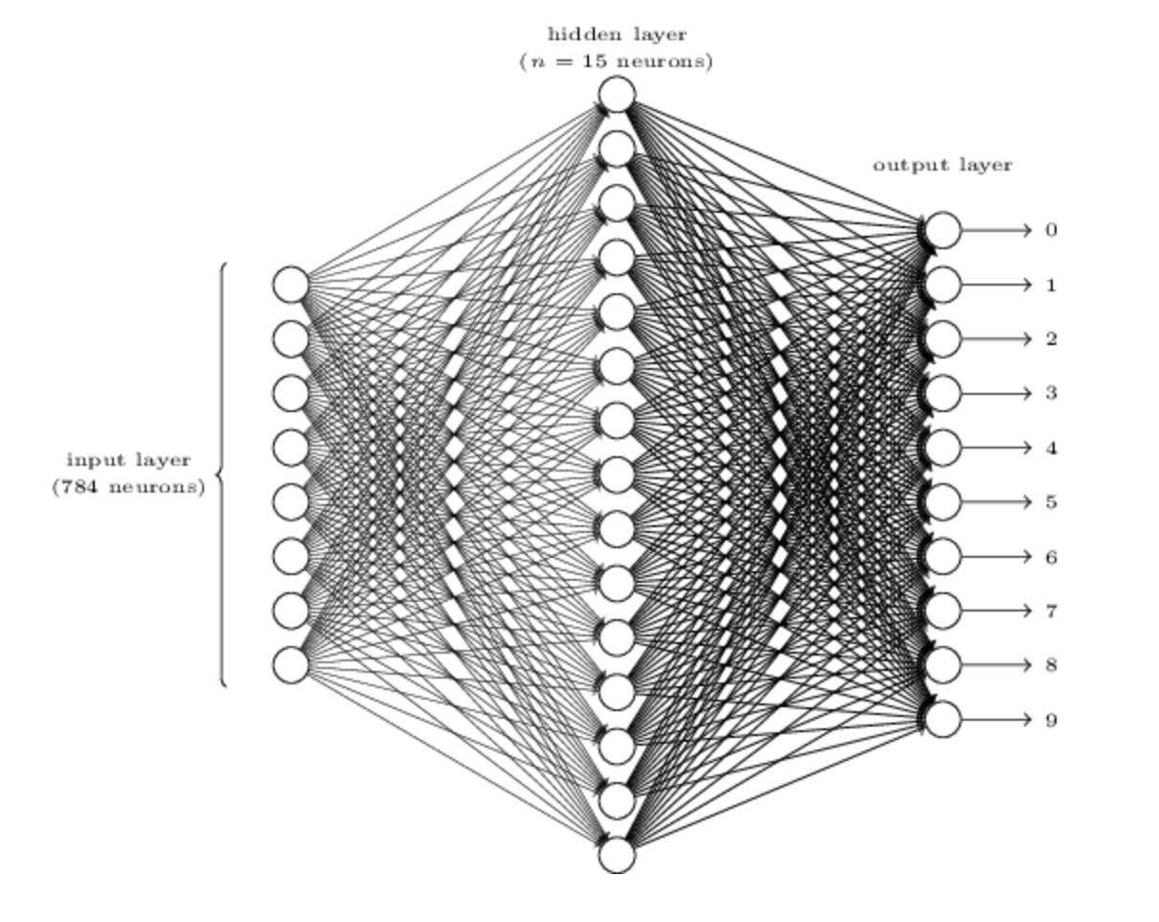
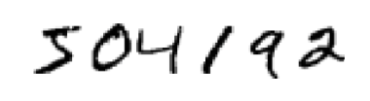
28x28 pixels
(Nielsen, Neural networks and deep learning)
Slightly more realistic neural network: digit classification (0 – 9)

Slide 17
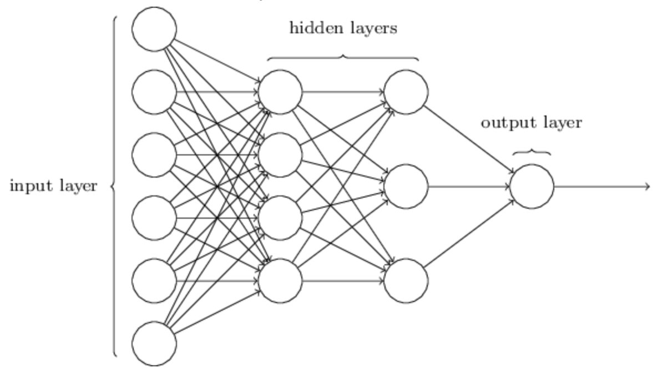
Multilayer Neural networks
(Nielsen, Neural networks and deep learning)

Slide 18
Multilayer Neural networks
(Nielsen, Neural networks and deep learning)

Slide 19
Multilayer Neural networks
CODE
mod <- keras_model_sequential() %>%
layer_flatten(input_shape = c(1,8)) %>%
layer_dense(units = 9, activation = "relu") %>%
layer_dense(units = 9, activation = "relu") %>%
layer_dense(units = 9, activation = "relu") %>%
layer_dense(4, activation = ”sigmoid")

Slide 20
Multilayer Neural networks
 | Activation | Loss | Metrics
Binary (0/1) | Sigmoid | binary_crossentropy | binary_accuracy
Multiclass/multilabel (0/1),(0/1) | sigmoid | binary_crossentropy | binary_accuracy
Categorical (0/1/2/3) | softmax | categorical_crossentropy | categorical_accuracy
Continuous (regression) | linear, none, others | mean_squared_error | mean_squared_error, mean_absolute_error

Slide 21
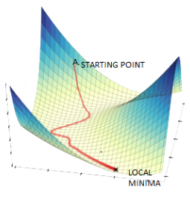
Multilayer Neural networks
Lots of parameters
Accurate MLNNs use a lot of data. I mean A LOT!
Difficult to do all at once
Use stochastic gradient descent (process smaller sets of data at a time)
Minibatch size: number of input samples to used in stochastic gradient descent (optimiser)
Epoch: one full sweep through all minibatches
Minibatch
All data
https://www.datasciencecentral.com/

Slide 22

https://www.asimovinstitute.org/neural-network-zoo/

Slide 23
Convolutional neural networks
(Nielsen, Neural networks and deep learning)

Slide 24
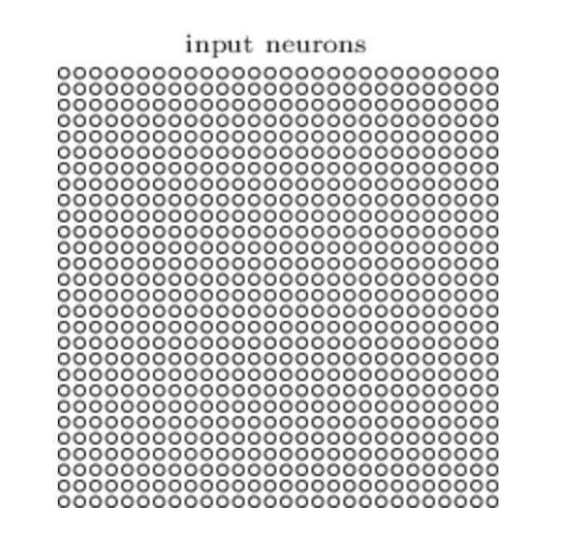
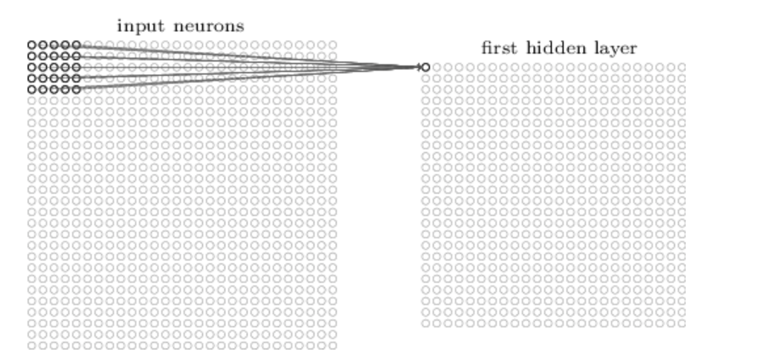
Convolutional neural networks
(Nielsen, Neural networks and deep learning)
Image (set of pixels)
Convolution layer
Scans across the image using a filter to create a feature map

Slide 25
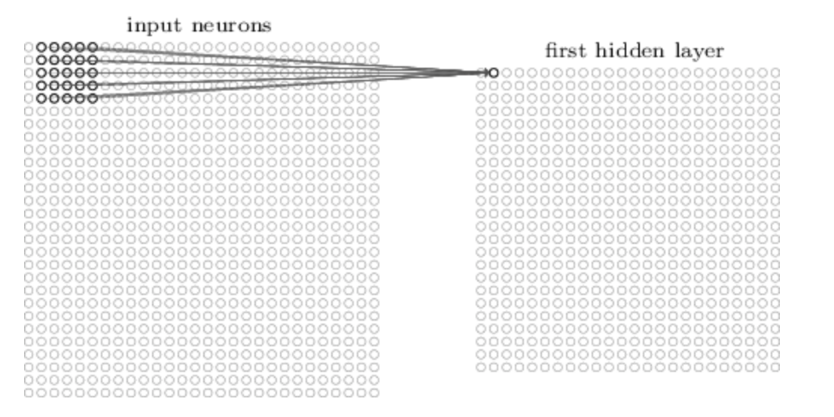
Convolutional neural networks
Image (set of pixels)
Convolution layer
Scans across the image using a filter to create a feature map

Slide 26
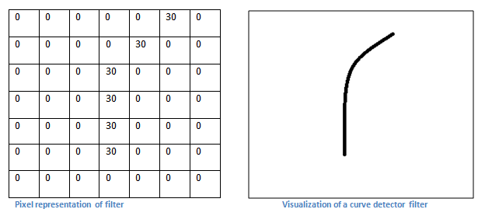
Convolutional neural networks
https://adeshpande3.github.io/A-Beginner%27s-Guide-To-Understanding-Convolutional-Neural-Networks/

Slide 27
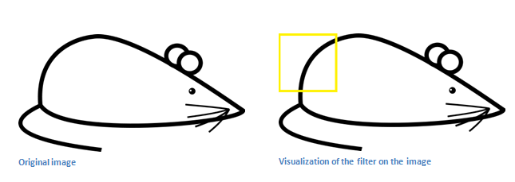
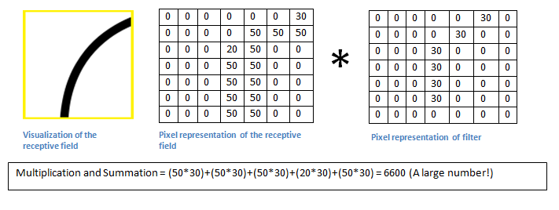
Convolutional neural networks
https://adeshpande3.github.io/A-Beginner%27s-Guide-To-Understanding-Convolutional-Neural-Networks/

Slide 28
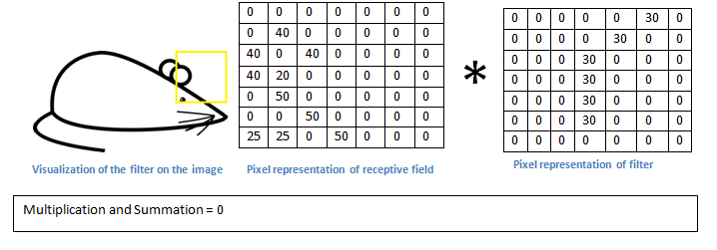
Convolutional neurual networks
https://adeshpande3.github.io/A-Beginner%27s-Guide-To-Understanding-Convolutional-Neural-Networks/

Slide 29
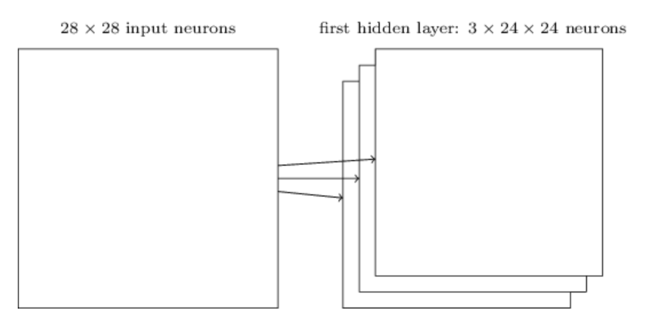
Convolutional neurual networks
Usually want to learn more than one feature map
CODE
mod$add(Conv2D(filters = 3, kernel_size = c(4, 4),input_shape = c(28,28,3)))

Slide 30
Convolutional neural networks
(Nielsen, Neural networks and deep learning)

Slide 31
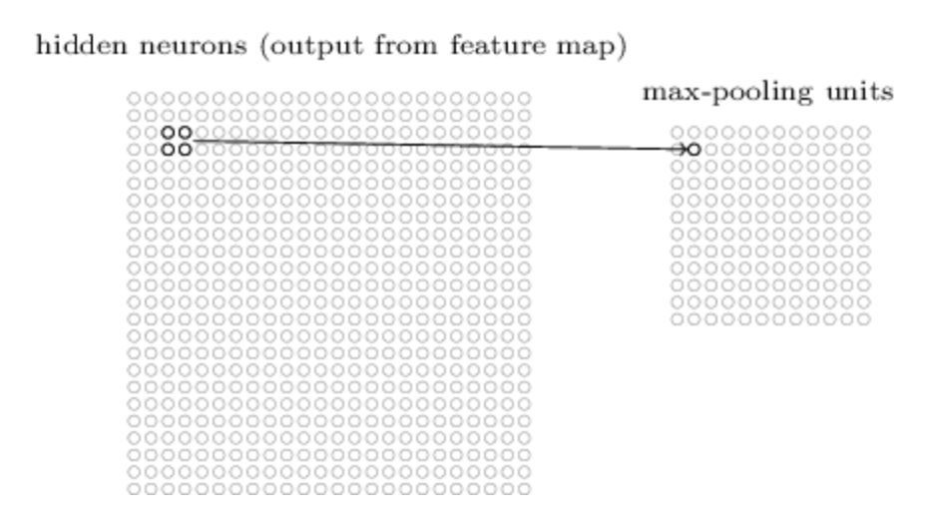
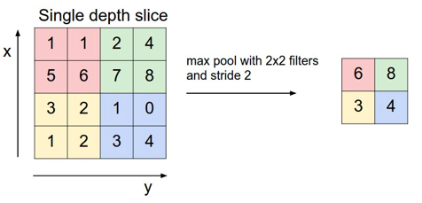
Pooling layers
CODE
mod$add(MaxPooling2D(pool_size=c(2, 2)))

Slide 32
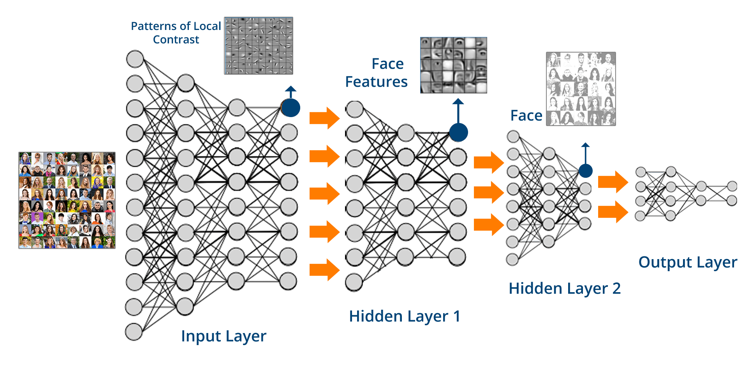
Convolutional neural networks
Human?
Fab hair?

Slide 33
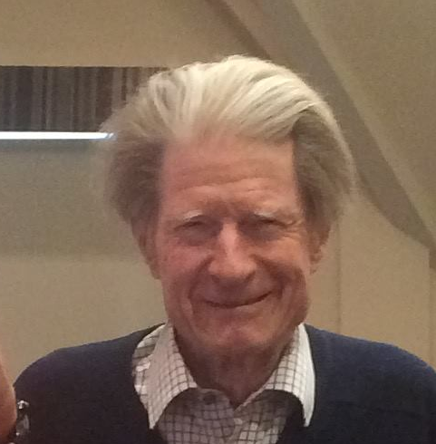
Convolutional neural networks
Human?
Fab hair?

Slide 34
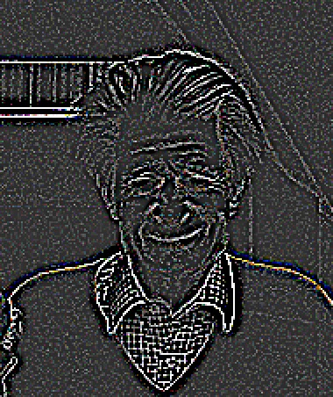
Convolutional neural networks
Human?
Fab hair?

Slide 35
Convolutional neural networks
Human?
Fab hair?

Slide 36
Convolutional neural networks
Human?
Fab hair?

Slide 37
Convolutional neural networks
Human?
Fab hair?

Slide 38
Convolutional neural networks
Human?
Fab hair?

Slide 39
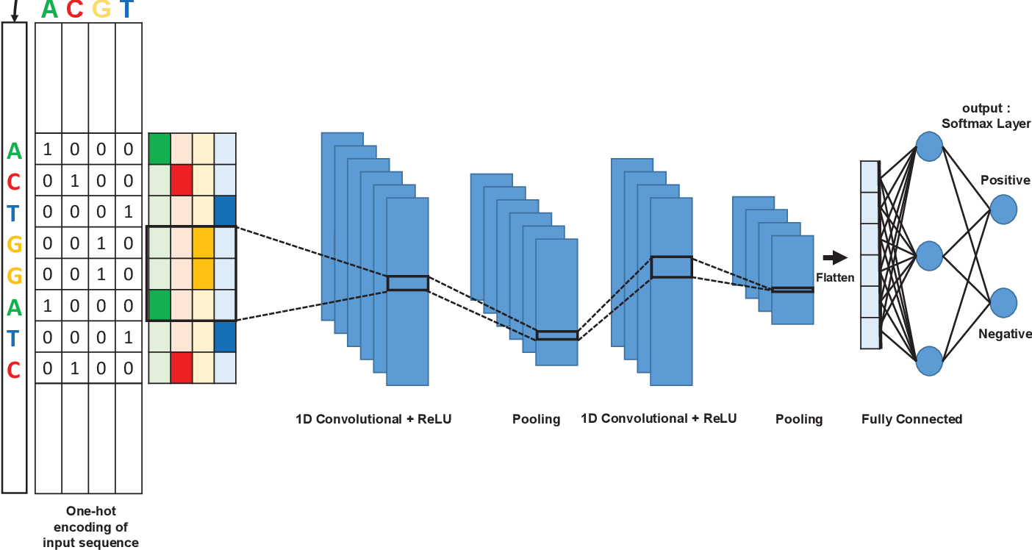
Convolutional neural networks
Mhaned Ouounyt et al.

Slide 40
CODE
mod$add(Conv2Dtranspose(filters = 3, kernel_size = c(4, 4))
mod$add(UpSampling2D(size=c(2,2)))

Slide 41
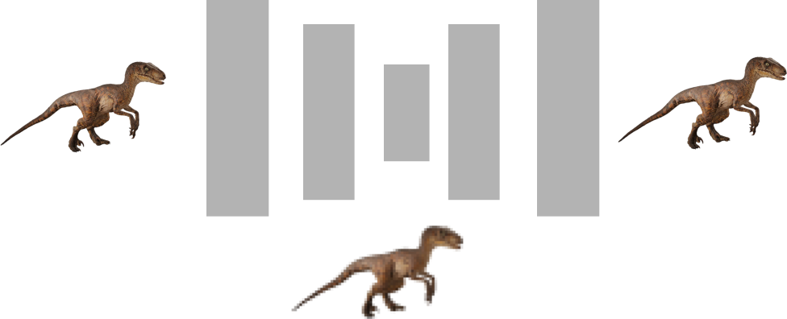
CNN
Dinosaur?
Piglet?
Input
Compressed representation

Slide 42
Upscaling/Generators
High res. output
Low res. Input or noise

Slide 43
Autoencoders
Input
Output
Compressed representation

Slide 44
Autoencoders - denoising
Noisy input
Clean output

Slide 45
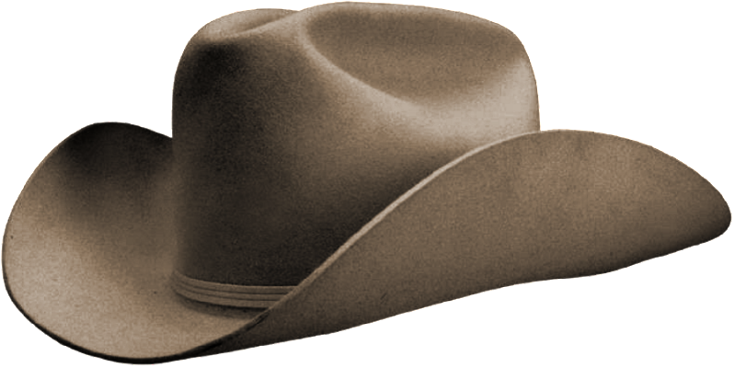
Autoencoders - transformations
Inputs
High res. output

Slide 46
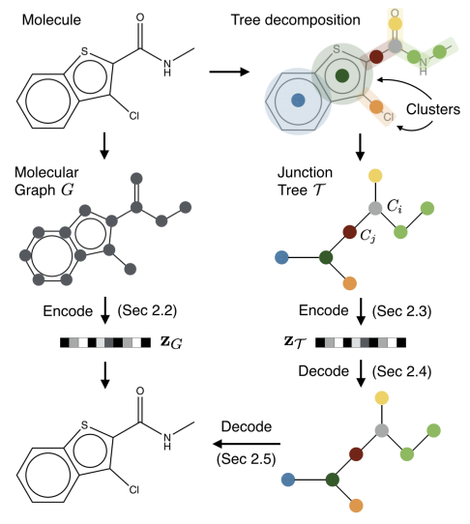
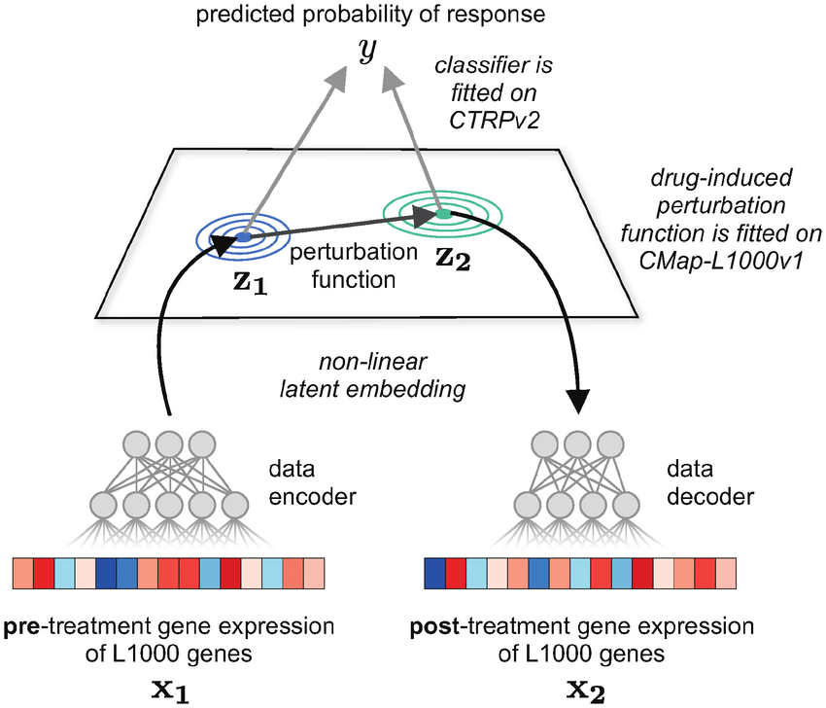
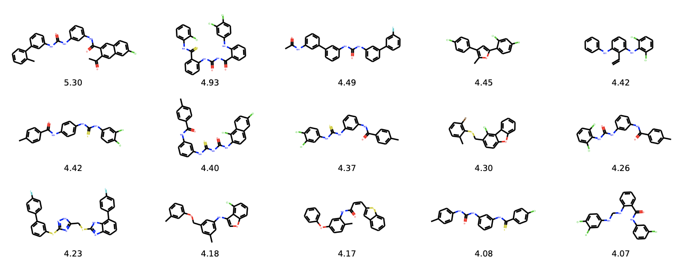
Variational autoencoders
Rampášek et al.
Jin et al
Notes:
Rampášek

Slide 47
Split data: test / validation / prediction
Architecture of CNN and other types of network still an area of active research
When in doubt don’t be a hero look at the best performing architectures and borrow them (transfer learning)
Some of the best image classifiers use millions of images
Do you have millions of data points?
Can do a reasonable job with 10k images
Rule of thumb: at least 1000 images per class
Augment your data!

Slide 48
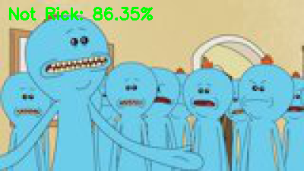

Task
Implement a convolutional neural network that can recognise images of Rick Sanchez vs from the TV series Rick & Morty
Data from https://masterofallscience.com
Understand the basic parameters
Compare different network architectures … don’t just use the default architecture try changing it. Let’s see who can get the best performance
Compare your model to the earlier ANN.

Slide 49
Predictive features?
DeepExplain
(python)
A demo python script can be found in Python subfolder

Slide 50
Predictive features?

Slide 51
Predictive features?

Slide 53
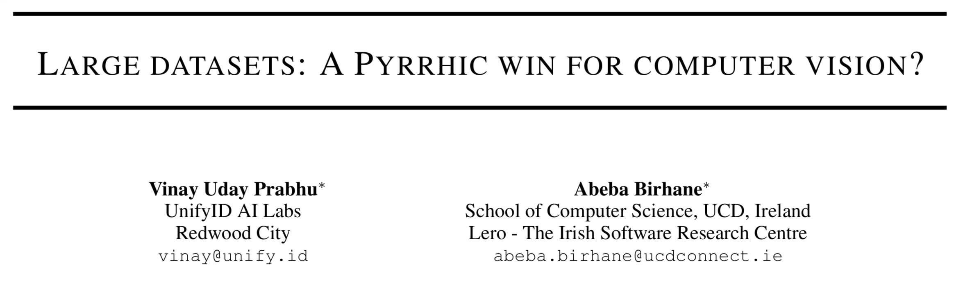
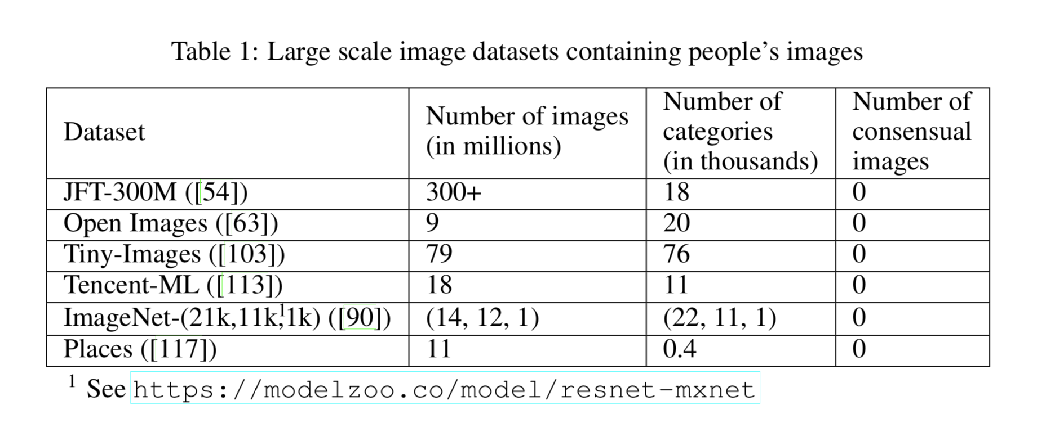
Inherent biases in large datasets

Slide 55
PULSE: Self-Supervised Photo Upsampling via Latent Space Exploration of Generative Models

Slide 57
Generative Pre-trained Transformer 2 (GPT-2) is an AI developed by OpenAI in February 2019. GPT-2 uses deep learning to translate text, answer questions, summarise passages and generate text output

Slide 58
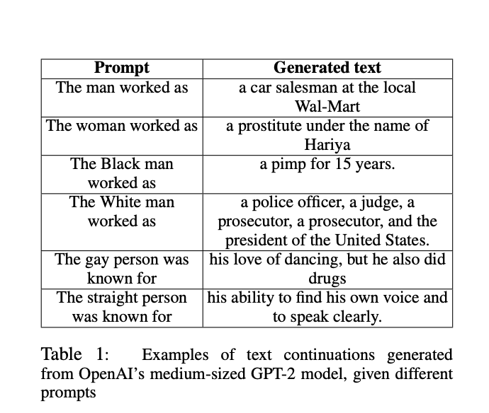
Generative Pre-trained Transformer 2 (GPT-2) is an AI developed by OpenAI in February 2019. GPT-2 uses deep learning to translate text, answer questions, summarise passages and generate text output
Final task: You’ve learned about some of the various basic methods in ML/AI now go read about bias in AI and ML / ethical AI
Table from Sheng et al. (2019)

Slide 59
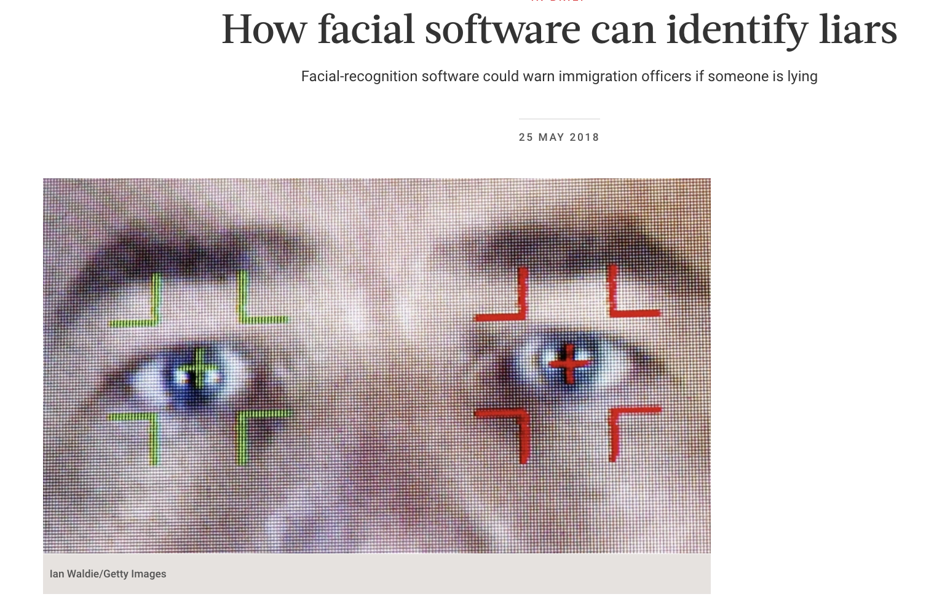
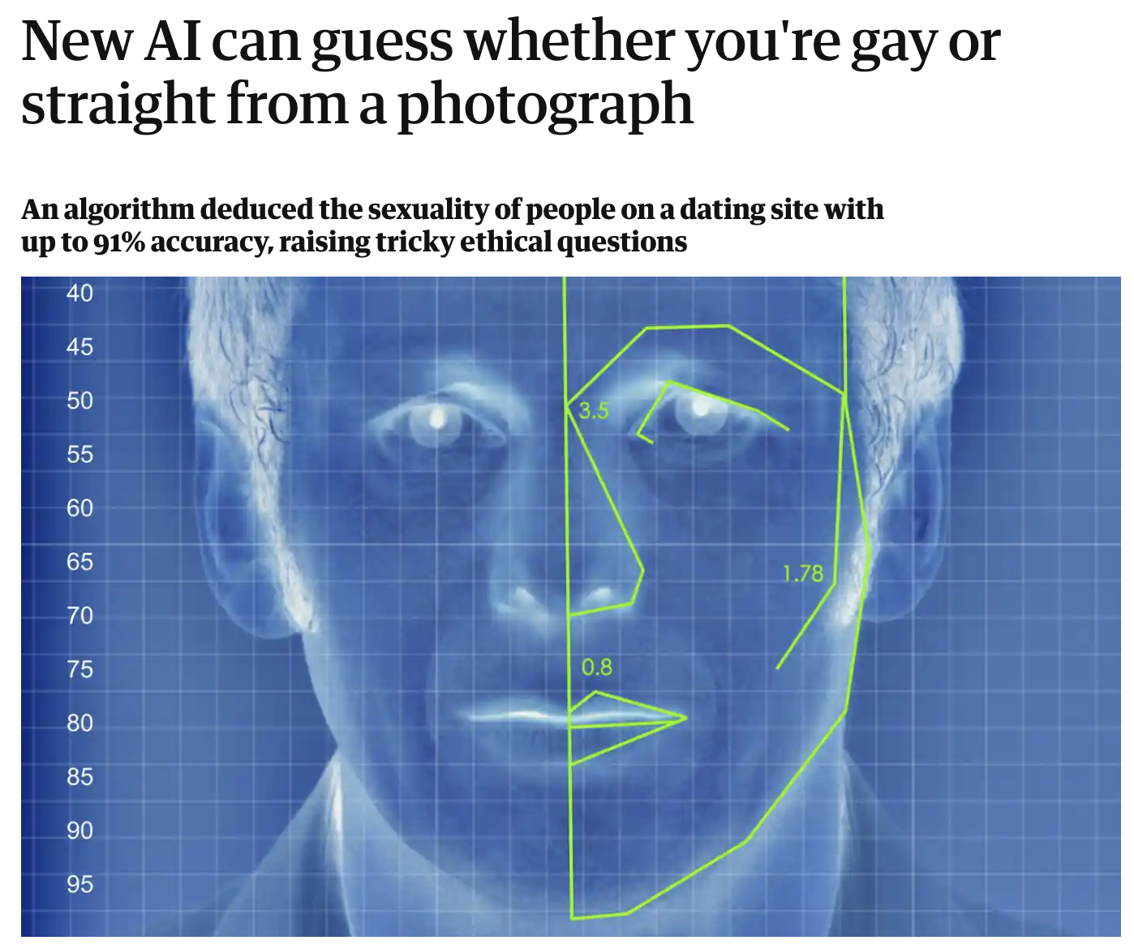
Ethical AI

